Slide 1
WTO implications: Can Border Carbon Adjustments (BCAs) be WTO compliant?
Ludivine Tamiotti
Trade and Environment Division (TED)
WTO
The following presentation is without prejudice to the positions of Members or to their rights and obligations under the WTO.

Slide 2
Key legal WTO questions will be defined by features that are yet to be designed, e.g.
What carbon price?
What emission intensity (ET) benchmark?
How to calculate ET (LCA) and who pays for certification?
What sectors covered?
How is the revenue used?
Are non-tax climate policies considered?
Are there exemptions for developing countries?
Are exports also adjusted (rebates)?
Aligned with existing (if any) relevant international standards?
Is there free allowances?
Is there an equivalent domestic tax?
Is carbon leakage happening?

Slide 3
Framework to analyse a bca: 3 key legal challenges
Coverage
Consistency
Justifiability

Slide 4
Coverage
BCA on imports
BCA on exports
Or
Taxes on products
Taxes on producers
Or
Internal tax
Another requirement
Or
Border tax adjustment
Customs duty
Or

Slide 5
Consistency
Non Discrimination
National treatment
Most Favoured Clause
Like products (Art. III.2 & 4)
An article from which the imported product has been manufactured (Art. II.2)?
Is carbon “incorporated” into the product like chemicals? Energy? (“Superfund” case)

Slide 6
Justifiability
GATT Art. XX
For adjustments on imports
The environmental objective has to be at the centre
Carbon leakage and environmental justification
Environmental effectiveness of the measure
Comparability: other measures of exporting country?
Holistic, in line with other international commitments
Implementation is key

Slide 7
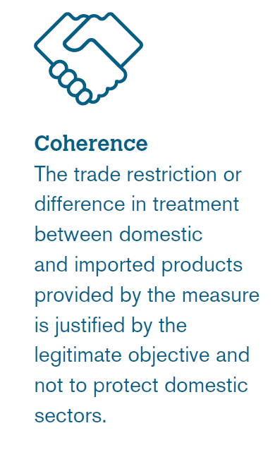
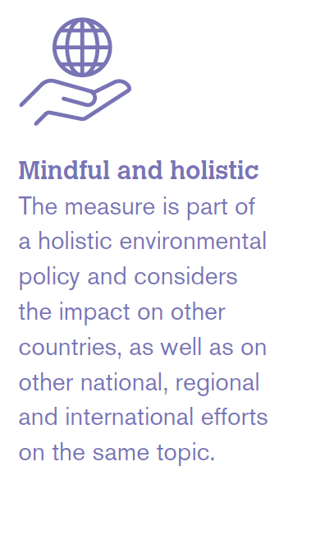
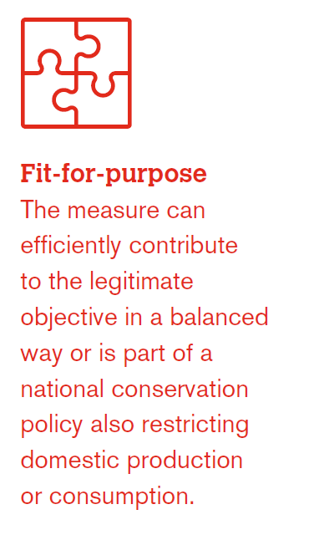
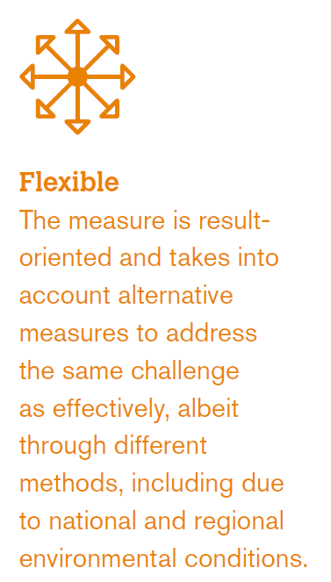
Based on past WTO disputes, several useful “checks”, including:
What to keep in mind when developing a trade-restrictive
environmental measure

Slide 8
Role of WTO Rules
From the misperception that WTO rules act as an obstacle to climate regulations
… to seizing the opportunity to develop and implement better regulations

