Slide 1
Andrei Marcu
BCA in the international context of climate change
March 4, 2021
Notes:
It is a long slide show, so we’ll go quickly over background etc to have time to focus on the core issues!

Slide 2
BCA Definition
Border carbon adjustments (BCAs) seek to alleviate negative effects of asymmetrical climate policies
They can have three main objectives:
  level the playing field in competitive markets
  prevent leakage of carbon emissions to jurisdictions with weaker policies
  incentivise trade partners to strengthen their own climate efforts

Slide 3
International climate situation: asymmetry of climate targets
Several countries have announced Net Zero targets by 2050 (China 2060) however only a few countries increased their ambition in the updated NDC targets by 2030
2030 Climate Targets
EU: “Endorses a binding EU target of reduction of at least 55% in greenhouse gas emissions by 2030 compared to 1990. Calls on the co-legislators to reflect this new target in the European Climate Law proposal and to adopt the latter swiftly” (11 Dec 2020)
73 countries (including EU 27) have submitted a new or updated NDC
However out of this 73 only a few countries submitted a stonger NDC target: EU (as a party), Argentina, Chile, Ethiopia, Kenya, Nepal, Norway, UAE, UK
2050 Net Zero Targets
58 countries have communicated a net-zero targets including: EU (as a party), Canada, USA, UK, Japan, South Africa, South Korea and China (by 2060), etc.
Source: Climatewatch, 2020

Slide 4
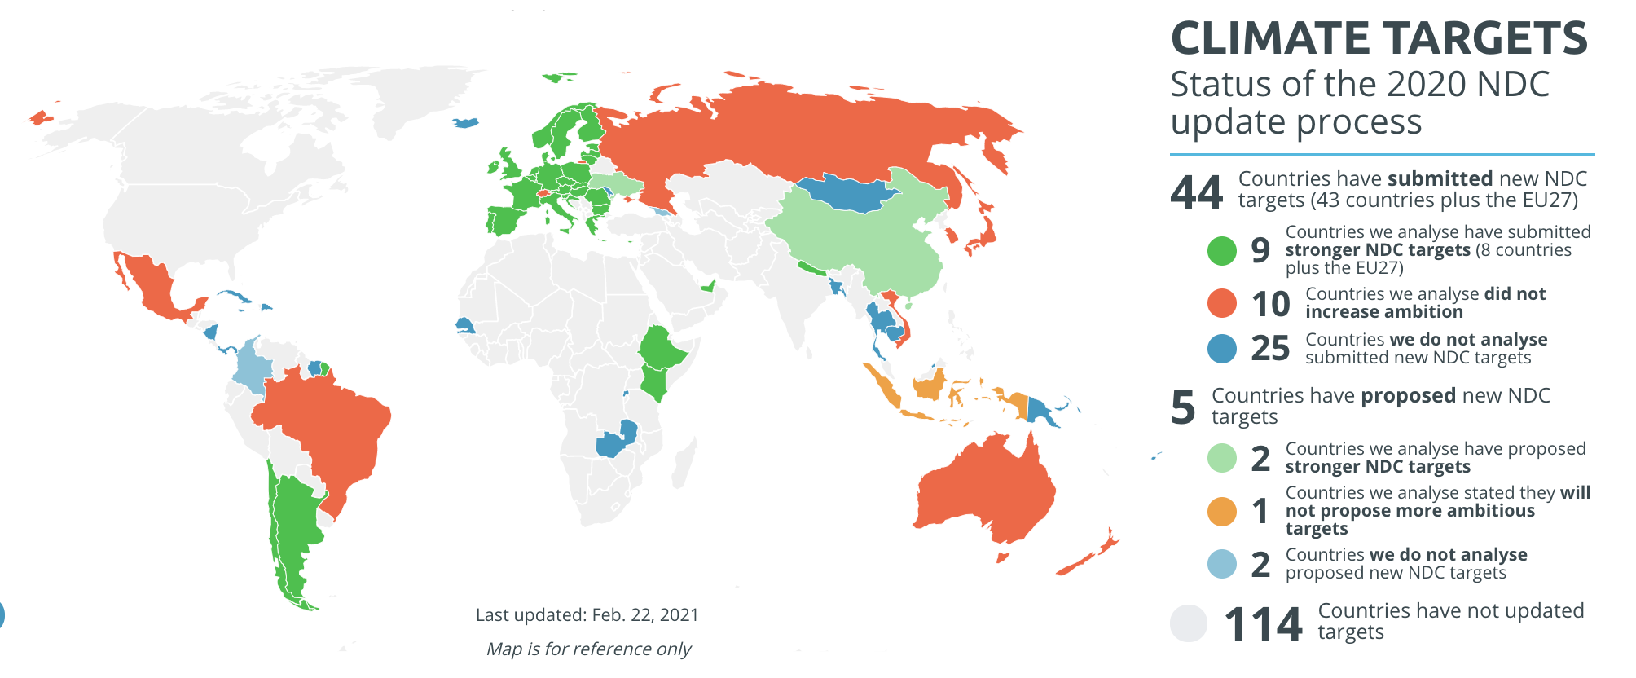
2030 Climate Targets: European Union ahead of the curve compared to the rest of the world
Source: Climate Action Tracker, 2021

Slide 5
How does it fit in UNFCCC negotiations
Article 4.8 of the Convention “The developed country Parties and other developed Parties included in Annex II shall also assist the developing country Parties that are particularly vulnerable to the adverse effects of climate change in meeting costs of adaptation to those adverse effects.”
Article 2.3 of the Kyoto Protocol “Parties included in Annex I shall strive to implement policies and measures under this Article in such a way as to minimize adverse effects, including the adverse effects of climate change, effects on international trade, and social, environmental and economic impacts on other Parties ...”
Article 3.14 of the Kyoto Protocol “Each Party included in Annex I shall strive to implement the commitments mentioned in paragraph 1 above in such a way as to minimize adverse social, environmental and economic impacts on developing country Parties. … Parties to this Protocol shall, at its first session, consider what actions are necessary to minimize the adverse effects of climate change and/or the impacts of response measures on Parties referred to in those paragraphs …”
Article 4.15 of the Paris Agreement “Parties shall take into consideration in the implementation of this Agreement the concerns of Parties with economies most affected by the impacts of response measures, particularly developing country Parties.”
Notes:
https://unfccc.int/topics/mitigation/workstreams/response-measures/background-on-adverse-effects--response-measures#:~:text=Article%204.8%20of%20the%20Convention,and%20countries%20whose%20economies%20are

Slide 6
BCA discussion Status – climate diplomacy
US overview – White House carbon neutrality annoucements
  California - existing BCA for electricity
  New York State - draft of a Carbon Pricing Proposal containing the BCA provision
US/China/EU cooperation – potentially covering over 60% of global emissions
Canada and the provincies exploring the potential of a border carbon adjustment (Biden – Trudeau cooperation)
UK - COP 26 and G7 presidencies
Ukraine - adopting EU’s acquis, potentially ready to be included in the EU CBAM
China Remains cautious towards the EU CBAM (trade issues)

Slide 7
Preliminary results for India - Steel
Preliminary results
 | Crude steel CO2 intensity - tCO2/ton of product
 | Direct emissions | Direct & indirect emissions
EU27 | 0,72 | 1,10
India | 1,16 | 2,06
Notes:
Emission intensities associated with specific production routes (BF-BOF, scrap-based EAF, DRI-EAF) from IEA Iron and Steel Technology Roadmap (2020)
Crude steel production mix by process technology based on World Steel Association data, Indian Ministry of Steel
Preliminary results

Slide 8
Why Are We Discussing This Now?
Paris Agreement →
  Continued asymmetry of climate efforts - NDC nationally determined
  Paris Agreement objectives
    Carbon neutrality
    1.5/2 ⁰ C
European Green Deal
    EU Climate Law and carbon neutrality
    Increase 2030 level of ambition from -40% to -55%
    EUA prices --- from 5 to 40

Slide 9
Competition and carbon leakage in the EU
Competition and carbon leakage always a concern in the EU due to EU ETS
Addressed through
  Free allocation for direct emissions
  Financial compensation for indirect costs (electricity)
  Economic recession, low EUA prices
  International credits under KP
  International aviation in EU ETS …. Stop the clock…Corsia
World changes, circumstances change - in the EU old methods may not work

Slide 10
World changes, circumstances change
EUA prices increase
Running out of free allocation
Paris Agreement strong objectives

Slide 11
EUA futures, July 2008 – 1 March 2021
Source: ICE

Slide 12
Availability of Free Allocation
The cross-sectoral correction factor (CSCF) under higher EU 2030 target scenarios
Projected free allocation ‘needs’ vs. the EU ETS cap under higher EU 2030 target scenarios
Source: Agora Energiewende

Slide 13

What Do We Know So Far?
Political Guidelines of 16 July 2019:
  ‘To complement this work, and to ensure our companies can compete on a level playing field, I will introduce a Carbon Border Tax to avoid carbon leakage. This should be fully compliant with World Trade Organization rules. It will start with a number of selected sectors and be gradually extended.’

Slide 14
Europe‘s Border Carbon Adjustment: State of Play
December 2019: European Council endorses work, states that ‘facilities in third countries need to adhere to the highest environmental … standards’
March 2020: Inception Impact Assessment Roadmap and public
consultation on the elements of the CBAM feedback IA; 219 submissions
May 2020: European Commission mentions CBAM revenue (‘€5 to €14 billion per year’) as potential source for EU Recovery Plan (‘Next Generation EU’)
Confirmed by the historical EUCO in July (EU budget 2021-2027, Recovery Package) – BCA introduction by 2023
Public consultations done October 28
Next steps: Impact assessment and proposal expected around June 2021

Slide 15
European Commission main options
A tax applied on imports at the EU border
  On products whose production is in sectors that are at risk of carbon leakage
  This could be a border tax or customs duty
An extension of EU Emission Trading Scheme to imports
  Requiring the purchasing of emission allowances under the EU ETS by either foreign producers or importers
Carbon tax (e.g. excise or VAT type) at consumption level
  On products whose production is in sectors that are at risk of carbon leakage
  The tax would apply to EU production, as well as to imports
The obligation to purchase allowances from a specific pool outside the ETS
  Dedicated to imports, which would mirror the ETS price

Slide 16
EP own initiative (ENVI 4/5 Feb vote)
1.Policy mechanism: notional EU ETS (or evolving tax that mirrors dynamic evolution of EUA price)
2.Coverage of trade flows: imports + possible export rebates limited to EU better performers under certain caveats (WTO compatibility, environmental performance)
3.Geographic scope: possible exemptions for LDCs and SIDSs (or/and use of revenues for climate finance in LDCs and SIDSs)
4.Sectoral scope: pilot CBAM for power, cement, steel, aluminium, oil refinery, paper, glass, chemicals and fertilisers as of 2023, and eventual roll-out to all products/commodities covered by ETS sectors; coverage of intermediate and final products in the value chain (timing unclear, could be later rather than from the outset)
5.Emissions scope: Scope 1 and Scope 2 emissions; recognition of full life-cycle emissions importance, but no desire to cover Scope 3 at this stage
6.Approach to determining embedded emissions: use of national/installation-level carbon intensity data in exporting countries; in absence of such data, global average carbon intensities of individual products taking into account specific production methods
7.Crediting for foreign climate policies: ensure crediting; open to interpretation whether crediting refers to carbon pricing policies only
8.Use of revenue: EU own resources supporting domestic climate and EGD objectives (EU just transition/decarbonisation) and contributing to international climate finance in favour of LDCs and SIDSs
9.Treatment of existing carbon leakage measures: gradual, eventually complete phase out of existing CL measures

Slide 17
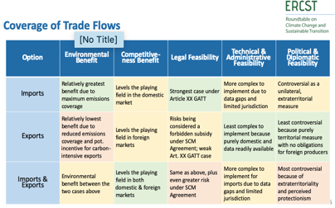
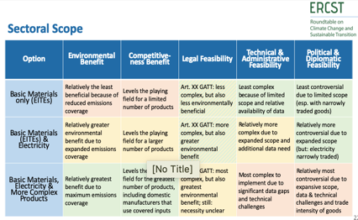
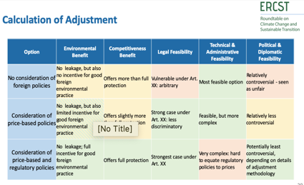
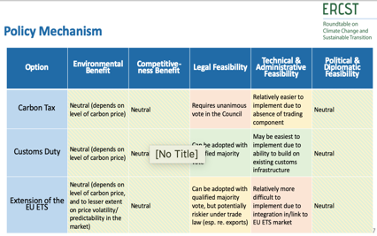
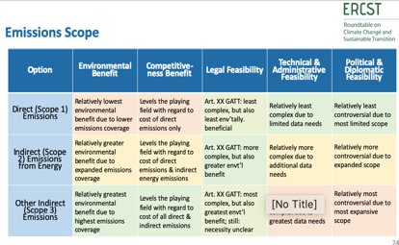
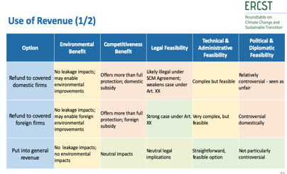
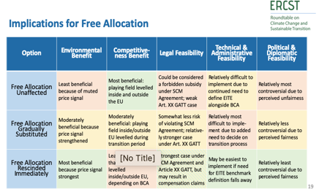
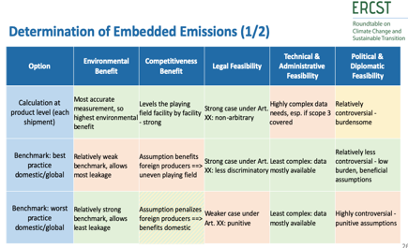
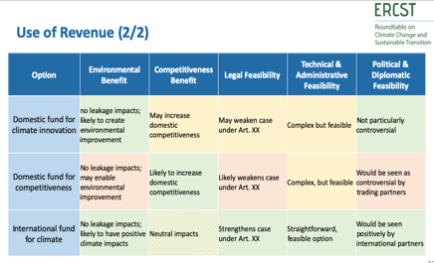
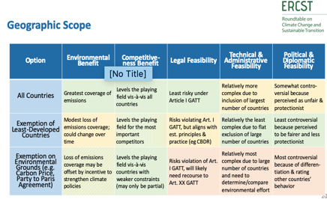
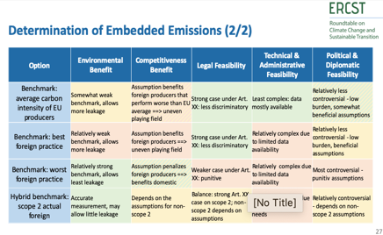
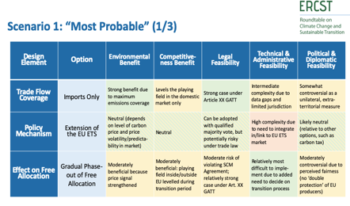
Our Approach: Decomposing, Evaluating & Comparing
Design Elements:
Coverage of trade flows
Policy mechanism
Geographic scope
Sectoral scope
Emissions scope
Determination of embedded emissions
Calculation of adjustment
Use of revenue
Evaluation Criteria:
Environmental benefit
Competitiveness benefit
Legal feasibility
Technical and administrative feasibility
Political feasibility
  Material neutrality
  Global environmental benefits
Scenario-Building:
‘Most Probable’
‘Play it Safe’
‘Go Getter’
Comparisons with alternative instruments

